Slide 1
Logistics Optimization for Delivery Routes of DHL
SQL Analytics Project
Name: Ananta Kumar Nayak
Course: Data Science (Internshala) | Date: Jan 2026

Slide 2
Project Overview
DHL operates a global logistics network with multiple routes, warehouses, and delivery agents.
Delays can occur due to route congestion, customs, weather, and last-mile issues.
This project uses SQL to analyze shipment data and identify:
a. Delay patterns
b. Inefficient Routes
c. Warehouse and agent performance issue
The goal is to improve on-time delivery and operational efficiency.

Slide 3
Data set used
Orders
Routes
Warehouses
Delivery Agents
Shipments

Slide 4
TASK 1 (Data cleaning & preparation) 1.1 Identify and delete duplicate Order_id,Shipment_id
SELECT Shipment_ID, COUNT(*) AS total_records FROM shipments GROUP BY Shipment_ID HAVING COUNT(*) > 1;
This syntax identify the shipment which have duplicate value from shipment table.
SELECT Order_ID, COUNT(*) AS total_records FROM ordersGROUP BY Order_IDHAVING COUNT(*) > 1;
This syntax identify the order id which have duplicate value from orders table.

Slide 5
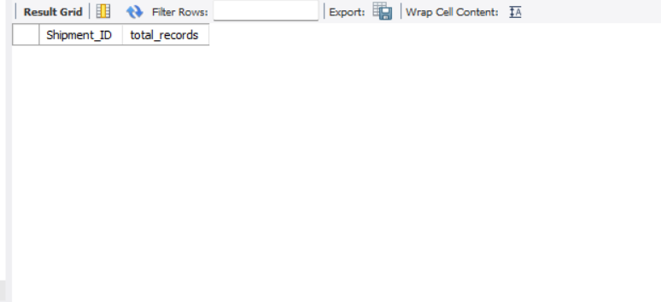
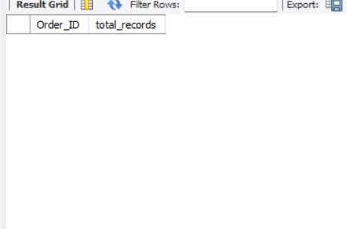

Slide 6
1.2 Replace null or missing delay hours with average delay for the rout_id
UPDATE shipments s JOIN (SELECT Route_ID, AVG(Delay_Hours) AS avg_delay FROM shipments WHERE Delay_Hours IS NOT NULL GROUP BY Route_ID)r ON s.Route_ID = r.Route_ID SET s.Delay_Hours = r.avg_delay WHERE s.Delay_Hours IS NULL;
This syntax find out all value where the delay hour is null from shipments table and for replacing with the average delay for the rout id it joins the shipments table with routes table and perform the aggregation.
Since there is no null value so update effect 0 row.

Slide 7
1.3 Converting all date column to YYYY-MMM-DD HH-MM-SS
UPDATE orders SET Order_Date = STR_TO_DATE(Order_Date, '%Y-%m-%d %H:%i:%s’);
This syntax standardize the order date format from orders table.
UPDATE shipments SET Pickup_Date = STR_TO_DATE(Pickup_Date, '%Y-%m-%d %H:%i:%s’);
This syntax standardize the shipment date format from shipments table.

Slide 8
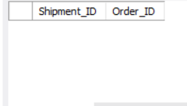
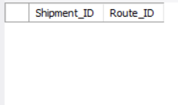
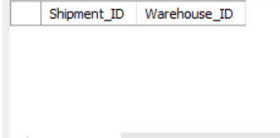
1.4 Validating Referential Integrity
SELECT Shipment_ID, Order_IDFROM shipments WHERE Order_ID IS NULL;
SELECT Shipment_ID, Route_IDFROM shipments WHERE Route_ID IS NULL;
SELECT Shipment_ID,Warehouse_IDFROM shipments WHERE Warehouse_ID IS NULL;
This syntax validating referential integrity by finding out any null order id, route id,
and warehouse id.
This are the result table which I get after running the code and no null record found.

Slide 9
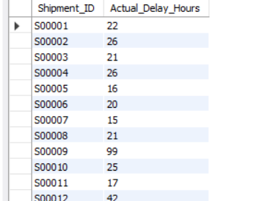
Task 2 (Delivery Delay Analysis) 2.1 Calculating delivery delay (in hours) for each shipment
ALTER TABLE shipments ADD COLUMN Calculated_Delay_Hours INT;
UPDATE shipments SET Calculated_Delay_Hours = TIMESTAMPDIFF(HOUR, Pickup_Date, Delivery_Date);
This syntax will alter the shipment table and create a new column called calculated delay hours and update function is updating the value in this by calculating the difference between pickup date and delivery date in hours.
SELECT Shipment_ID,calculated_delay_hours AS Actual_Delay_Hours FROM shipments;
This syntax is used to see the result.

Slide 10
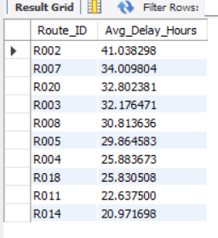
2.2 Finding out the Top 10 delayed routes based on average delay hours
SELECT Route_ID,AVG(delay_hours) AS Avg_Delay_Hours FROM shipments GROUP BY Route_ID ORDER BY Avg_Delay_Hours DESC LIMIT 10;
This syntax is find out the top 10 routes which have the highest average delay hours.

Slide 11
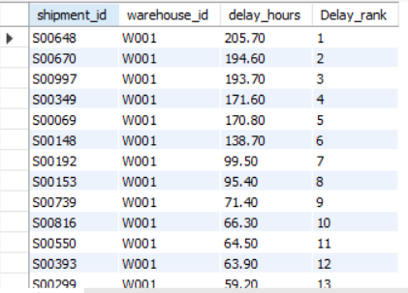
2.3 By using window functions ranking warehouse on the basis of delay
select shipment_id,warehouse_id,delay_hours, rank()over(partition by warehouse_id order by delay_hours desc) as Delay_rankfrom shipments;
In this syntax calculating delay hours for each warehouse and after that arranging in the descending order after that giving rank by using window rank function.

Slide 12
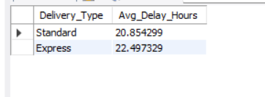
2.4 Identifying the average delay per Delivery Type
SELECT o.Delivery_Type,AVG(s.Delay_Hours) AS Avg(Delay_Hours) FROM shipments s JOIN orders o ON s.Order_ID = o.Order_IDGROUP BY o.Delivery_Type;

Slide 13
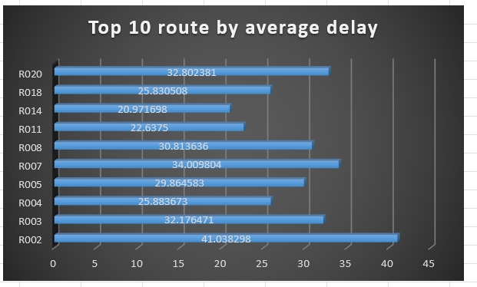
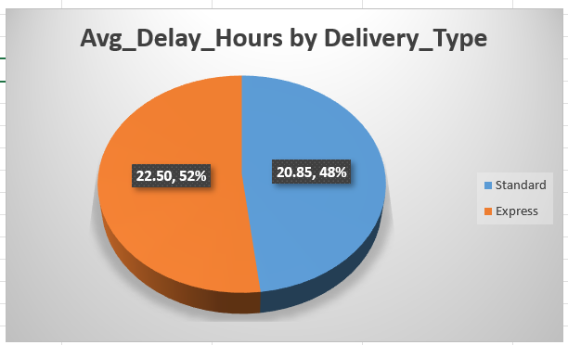
Task 2 Visuals

Slide 14
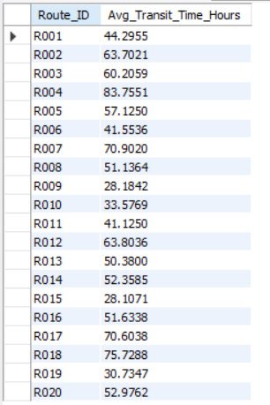
Task 3(Route Optimization Insights) 3.1 calculating average transit time (in hours) across all shipments
SELECT Route_ID,AVG(Calculated_Delay_Hours) AS Avg_Transit_Time_Hours FROM shipments GROUP BY Route_ID;
This syntax calculate avg of calculated delay hours(Difference of pickup date and delivery date) and the aggregation is performed for each route.

Slide 15
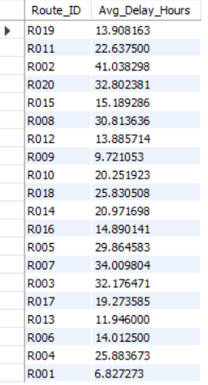
3.2 Average delay (in hours) per route
SELECT Route_ID,AVG(Delay_Hours) AS Avg_Delay_HoursFROM shipments GROUP BY Route_ID;
This syntax calculate the average of delay hours(Difference between delivery date and excepted delivery date) the aggregation performed on the basis of route id.

Slide 16
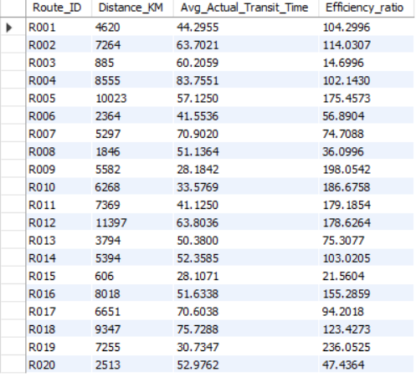
3.3 Calculating distance-to-time efficiency ratio
SELECT r.Route_ID,r.Distance_KM, AVG(s.Calculated_Delay_Hours) AS Avg_Actual_Transit_Time,(r.Distance_KM / AVG(s.Calculated_Delay_Hours)) AS Efficiency_ratio FROM routes r JOIN shipments s ON r.Route_ID = s.Route_ID GROUP BY r.Route_ID, r.Distance_KM order by Route_ID;
To calculate distance to time efficiency ratio for each route required distance which is available in route table and the average transit time which is available in the shipments table so by using join both the table is join on the basis of common column which is route id.

Slide 17

3.4 Top 3 routes with the worst efficiency ratio
SELECT r.Route_ID,r.Distance_KM,AVG(s.Calculated_Delay_Hours) AS Avg_Actual_Transit_Time,(r.Distance_KM / AVG(s.Calculated_Delay_Hours)) AS Efficiency_ratioFROM routes r JOIN shipments s ON r.Route_ID = s.Route_ID GROUP BY r.Route_ID, r.Distance_KM order by Efficiency_ratio limit 3;
In this task also use the same aggregation which is used in previous task to calculate efficiency ratio after that arranging the ratio in ascending order and to calculate top 3 use limit function.

Slide 18
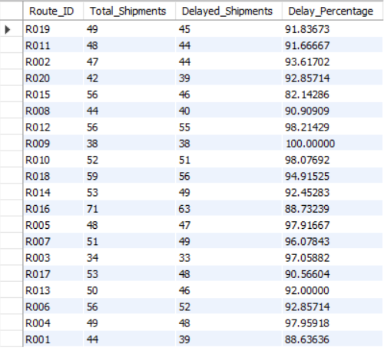
3.5 Routes with >20% of shipments delayed beyond expected transit time
SELECT Route_ID,COUNT(*) AS Total_Shipments,COUNT(CASE WHEN Delay_Hours > 0 THEN 1 END) AS Delayed_Shipments,(COUNT(CASE WHEN Delay_Hours > 0 THEN 1 END) * 100.0 / COUNT(*)) AS Delay_PercentageFROM shipments GROUP BY Route_ID HAVING Delay_Percentage > 20;
In this task first I have to calculate delayed shipments by using count and case it count all the shipment where delay hours is 0 after that calculate the delayed percentage by dividing the delayed shipments with total shipments and use having to use the condition which is delay percentage >20.

Slide 19
3.6 Recommendation
Routes with the lowest distance-to-time efficiency ratio and highest average delay should be prioritized for optimization.
Routes where more then 20% shipments are late may have traffic, customs, or capacity problems.
Warehouses connected to these routes may be overloaded so to avoid the warehouse issue should be considered for:
Capacity expansion
Process automation
To improve performance:
1. Use alternative routes with less congestion.
2. Increase number of vehicles or flights on busy routes.
3. Improve coordination at customs and sorting hubs.

Slide 20
Task 3 Visual’s

Slide 21

Task 4(Warehouse Performance) 4.1 Top 3 Warehouses with Highest Average Delay
SELECT Warehouse_ID,AVG(Delay_Hours) AS Avg_Delay_Hours FROM shipments GROUP BY Warehouse_ID ORDER BY Avg_Delay_Hours DESC LIMIT 3;
In this syntax first find out average of delay hours then grouping on the basis of warehouse id then arrange the average in descending order to find out the highest average delay and at the end put limit 3 to find out the top 3.

Slide 22
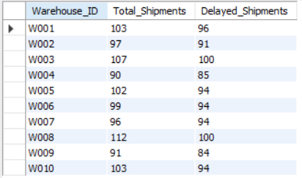
4.2Total Shipments vs Delayed Shipments for Each Warehouse
SELECT Warehouse_ID,COUNT(*) AS Total_Shipments,COUNT(CASE WHEN Delay_Hours > 0 THEN 1 END) AS Delayed_Shipments FROM shipments GROUP BY Warehouse_ID;
In this syntax first I calculate total shipment by using count after that calculating the delayed shipments by using count and case and at last comparing for each warehouse.

Slide 23
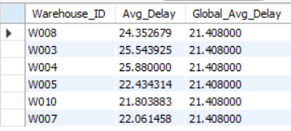
4.3Warehouses Where Average Delay Exceeds Global Average
WITH WarehouseAvg AS (SELECT Warehouse_ID,AVG(Delay_Hours) AS Avg_Delay FROM shipments GROUP BY Warehouse_ID),GlobalAvg AS (SELECT AVG(Delay_Hours) AS Global_Avg_Delay FROM shipments) SELECT w.Warehouse_ID,w.Avg_Delay,g.Global_Avg_Delay FROM WarehouseAvg w CROSS JOIN GlobalAvg g WHERE w.Avg_Delay > g.Global_Avg_Delay;
To compare warehouse average with global average first I create two CTE(common table expression) for each first CTE named as warehouse average where I calculate the average delay hours for each warehouse and the second CTE named as global average, calculate the overall average delay across all shipments. At the end I compared to identify the warehouses whose average delay is higher then the global average.

Slide 24
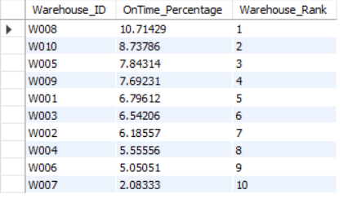
4.4Ranking Warehouses by On-Time Delivery Percentage
SELECT Warehouse_ID,(COUNT(CASE WHEN Delay_Hours = 0 THEN 1 END) * 100.0 / COUNT(*)) AS OnTime_Percentage, RANK() OVER (ORDER BY (COUNT(CASE WHEN Delay_Hours = 0 THEN 1 END) * 100.0 / COUNT(*)) DESC) AS Warehouse_Rank FROM shipments GROUP BY Warehouse_ID;
To rank warehouses on-time delivery percentage basis first I am calculating on time delivery percentage after that use RANK function to rank the warehouses.

Slide 25
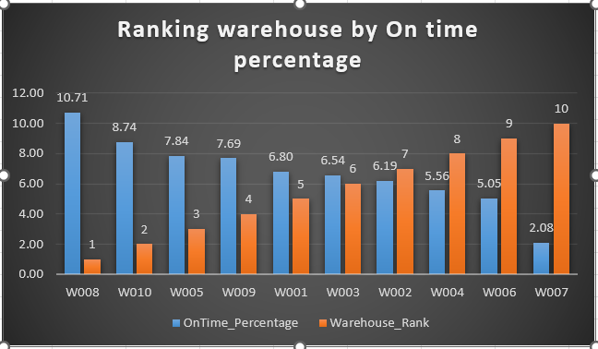
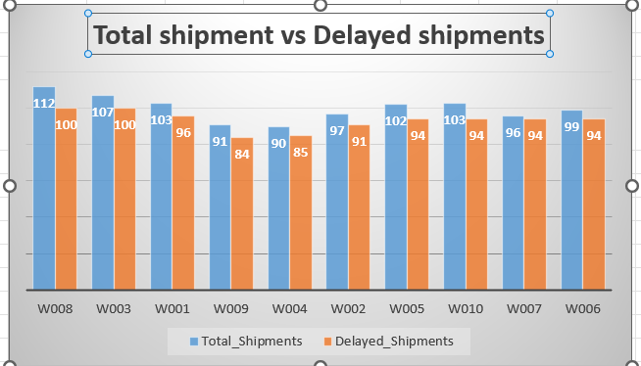
Task 4 Visuals

Slide 26
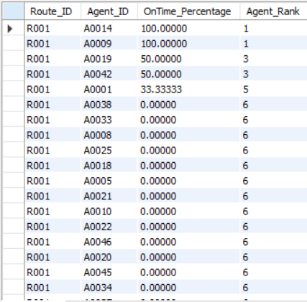
Task 5(Delivery Agent Performance) 5.1 Ranking Delivery Agents (per Route) by On-Time Delivery
SELECT s.Route_ID,s.Agent_ID,(COUNT(CASE WHEN s.Delay_Hours = 0 THEN 1 END) * 100.0 / COUNT(*)) AS OnTime_Percentage,RANK() OVER (PARTITION BY s.Route_ID ORDER BY (COUNT(CASE WHEN s.Delay_Hours = 0 THEN 1 END) * 100.0 / COUNT(*)) DESC) AS Agent_Rank FROM shipments s GROUP BY s.Route_ID, s.Agent_ID;
To ranking delivery agents first, I calculate the on-time delivery percentage then ranking the agents by using window ranking function.

Slide 27
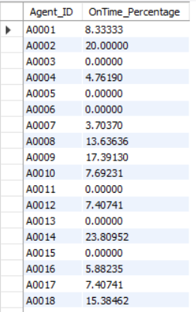
5.2 Finding agents who's on-time % is below 85%
SELECT s.Agent_ID,(COUNT(CASE WHEN s.Delay_Hours = 0 THEN 1 END) * 100.0 / COUNT(*)) AS OnTime_Percentage FROM shipments s GROUP BY s.Agent_ID HAVING OnTime_Percentage < 85;
In this syntax first, I calculate on-time percentage for each agent then use HAVING to implement the condition which is on-time Percentage < 85.

Slide 28

5.3 Compare Avg Rating & Experience of Top 5 vs Bottom 5 Agents based on on-time delivery%
SELECT 'Top 5 Agents' AS Category,AVG(d.Experience_Years) AS Avg_Experience, AVG(d.Avg_Rating) AS Avg_Rating FROM delivery_agents d JOIN (SELECT Agent_ID FROM shipments GROUP BY Agent_ID ORDER BY (COUNT(CASE WHEN Delay_Hours = 0 THEN 1 END) * 100.0 / COUNT(*)) DESC LIMIT 5) t ON d.Agent_ID = t.Agent_ID UNION ALLSELECT 'Bottom 5 Agents' AS Category,AVG(d.Experience_Years) AS Avg_Experience, AVG(d.Avg_Rating) AS Avg_Rating FROM delivery_agents d JOIN (SELECT Agent_ID FROM shipments GROUP BY Agent_ID ORDER BY (COUNT(CASE WHEN Delay_Hours = 0 THEN 1 END) * 100.0 / COUNT(*)) ASC LIMIT 5) b ON d.Agent_ID = b.Agent_ID;
To compare the average rating and experience of the top 5 and bottom 5 delivery agents, I used subqueries. First, I selected the top 5 agents based on highest on-time delivery percentage and calculated their average experience and rating. Then, I selected the bottom 5 agents based on lowest on-time delivery percentage and calculated their average experience and rating. This comparison helps to understand the performance difference between high-performing and low-performing agents.

Slide 29
5.4 Suggesting training or workload balancing strategies for low-performing agents
Based on the analysis, some delivery agents have a low on-time delivery percentage compared to others.
These agents should be given additional training on route planning, time management, and handling peak-hour deliveries.
Workload can be balanced by assigning fewer complex or long-distance routes to low-performing agents and gradually increasing their responsibility as their performance improves.
High-performing agents can be asked to guide or mentor them so that overall delivery performance can be improved.

Slide 30
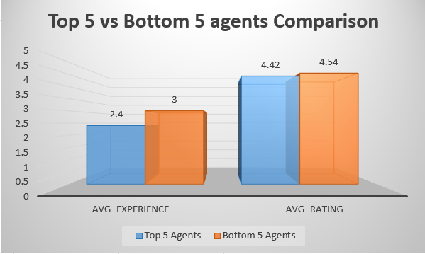
Task 5 visuals

Slide 31
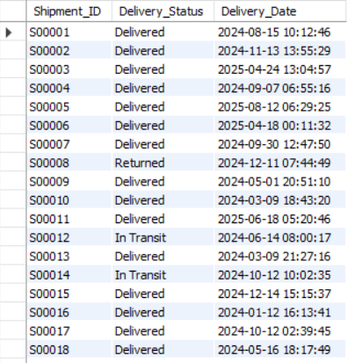
Task 6(Shipment Tracking Analytics) 6.1 Latest Status of Each Shipment
SELECT s.Shipment_ID,s.Delivery_Status,s.Delivery_Date FROM shipments s JOIN (SELECT Shipment_ID, MAX(Delivery_Date) AS Max_Date FROM shipments GROUP BY Shipment_ID) t ON s.Shipment_ID = t.Shipment_ID AND s.Delivery_Date = t.Max_Date;
To find the latest status of each shipment, first the maximum delivery date is calculated for every Shipment_ID using a subquery. Then, this result is joined with the Shipments table to get the corresponding Delivery Status for that latest date. This ensures that only the most recent record of each shipment is selected.

Slide 32
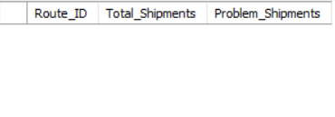
6.2 Routes where Majority of Shipments are in Transit or Returned
SELECT Route_ID,COUNT(*) AS Total_Shipments,COUNT(CASE WHEN Delivery_Status IN ('In Transit', 'Returned') THEN 1 END) AS Problem_ShipmentsFROM shipments GROUP BY Route_ID HAVING COUNT(CASE WHEN Delivery_Status IN ('In Transit', 'Returned') THEN 1 END) > COUNT(*) / 2;
In this query, the total number of shipments is counted for each route. Then, only those shipments with status “In Transit” or “Returned” are counted using a condition. The HAVING clause is used to check whether these problem shipments are more than half of the total shipments for that route. If this condition is true, the route is selected.
In our result, no route satisfied this condition, which means no route has a majority of shipments that are undelivered or returned.

Slide 33
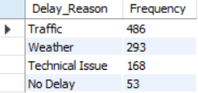
6.3 Identifying the Most Frequent Delay Reasons
SELECT Delay_Reason,COUNT(*) AS Frequency FROM shipments GROUP BY Delay_Reason ORDER BY Frequency DESC;
In this query, the Delay_Reason column is used to find the most common causes of delivery delays. Only records with a valid delay reason are selected. Then, the data is grouped by Delay_Reason and the number of shipments for each reason is counted. Finally, the results are sorted in descending order to identify the most frequent delay reasons.

Slide 34
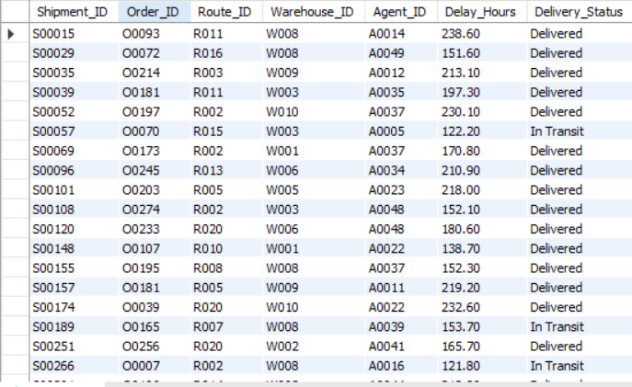
6.4 Identify Orders with Exceptionally High Delay (> 120 Hours)
SELECT Shipment_ID,Order_ID,Route_ID,Warehouse_ID,Agent_ID,Delay_Hours,Delivery_Status FROM shipments WHERE Delay_Hours > 120;
This query filters the shipments table to find orders that have a very high delay of more than 120 hours. By selecting only those records, we identify exceptional cases where deliveries are delayed for several days.

Slide 35
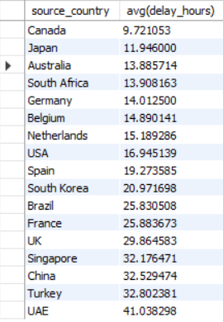
Task 7 7.1 Average Delivery Delay per Source Country
select r.source_country,avg(delay_hours) from shipments s join routes r on s.route_id=r.route_id group by source_country;
In this query, the Shipments table is joined with the Routes table to get the source country for each shipment. Then, the data is grouped by source country and the average delay hours are calculated. This shows which origin countries have higher average delivery delays.

Slide 36

7.2 On-Time Delivery Percentage
SELECT (COUNT(CASE WHEN Delay_Hours = 0 THEN 1 END) * 100.0 / COUNT(*)) AS OnTime_Delivery_Percentage FROM shipments;
This syntax calculates the overall on-time delivery percentage. Shipments with zero delay hours are considered on-time deliveries. The total number of on-time shipments is divided by the total number of shipments and multiplied by 100 to get the on-time delivery percentage.
This KPI shows how efficiently DHL is meeting its delivery timelines.

Slide 37
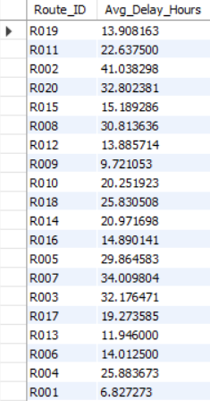
7.3 Average Delay per Route_ID
SELECT Route_ID,AVG(Delay_Hours) AS Avg_Delay_Hours FROM shipments GROUP BY Route_ID;
In this query, shipments are grouped by Route_ID and the average delay hours are calculated for each route. This helps identify which routes experience higher average delays.

Slide 38
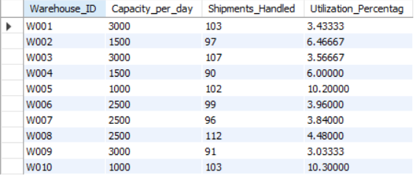
7.4 Warehouse Utilization Percentage
SELECT w.Warehouse_ID,w.Capacity_per_day,COUNT(s.Shipment_ID) AS Shipments_Handled, (COUNT(s.Shipment_ID) * 100.0 / w.Capacity_per_day) AS Utilization_Percentag FROM warehouses w LEFT JOIN shipments s ON w.Warehouse_ID = s.Warehouse_ID GROUP BY w.Warehouse_ID, w.Capacity_per_day;
In this task, the number of shipments handled by each warehouse is compared with its daily handling capacity. By dividing the total shipments by the warehouse capacity and converting it into a percentage, the utilization level of each warehouse is calculated.
This helps identify warehouses that are over-utilized or under-utilized and supports better capacity planning and workload distribution.

Slide 39
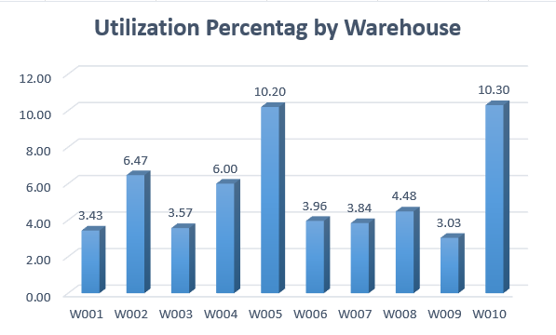
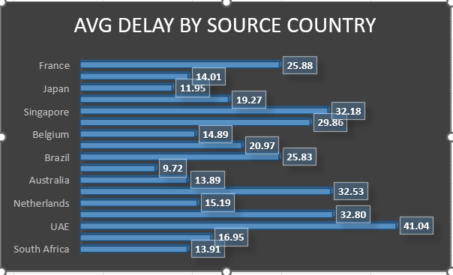
Task 7 Visuals

Slide 40
Key Insights & Business Recommendations for DHL
Key Insights:
Some routes have higher average delays and lower efficiency compared to others.
A few warehouses show higher delay and high utilization, indicating capacity and process issues.
Certain delivery agents have low on-time delivery percentages and need performance improvement.
Customs, traffic, and operational issues are common reasons for shipment delays.
Most shipments are delivered on time, but a small number face very high delays and need special attention.
Business Recommendations:
Optimize slow and high-delay routes by using alternative paths and better scheduling.
Improve operations at high-delay and warehouses by increasing staff planning.
Provide training and mentoring to low-performing delivery agents and balance their workload.
Focus on the most common delay reasons and take preventive actions such as better route planning and coordination.
Monitor severely delayed shipments separately to avoid repeated issues and improve customer satisfaction.

Slide 41
Video link
Task 1 to 5 explanation video link : https://www.loom.com/share/ad380637b77f4fc18c4f09aa7427adf5
Task 6 to 7 and insights and recommendation video link:
https://www.loom.com/share/0a9f132c0d0940aea5ab89de3880fb83
The reason of explaining my project into 2 video because in my free version of loom it only allow 5 minuets of recording so kindly consider my both videos.

